Slide 1
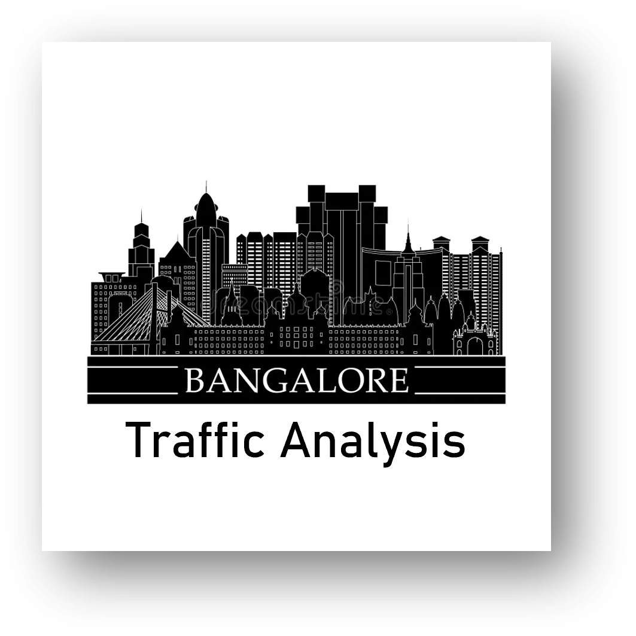
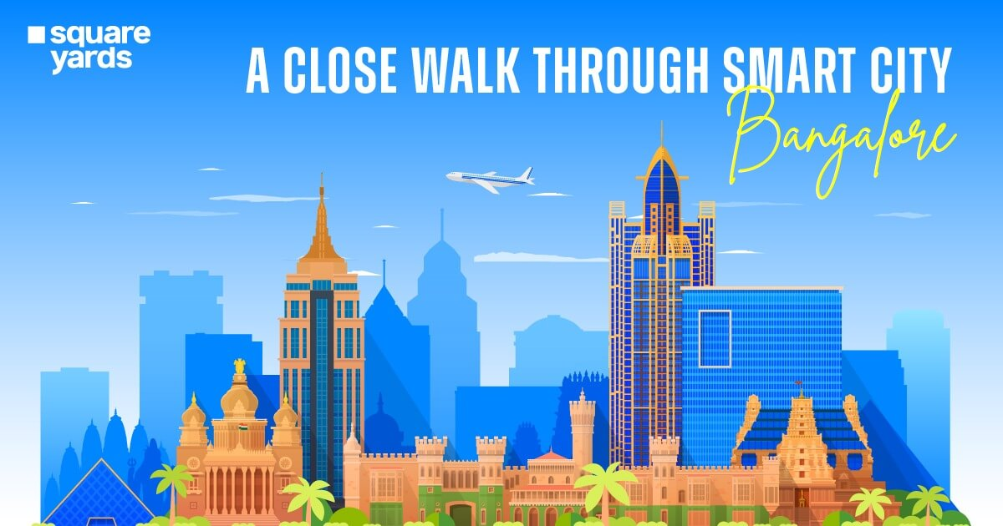
Smart City Traffic Analysis
- Analysis and Prediction of Bangalore Smart City Traffic Using Data Science and Machine Learning
Presented By
Mr. MDZ

Slide 2
Introduction
Content:
Objective: Analyze traffic data using exploratory data analysis (EDA) and machine learning to understand how factors like congestion level and average speed influence traffic volume. Build models that can explain and predict traffic behaviour in real-world scenarios.
Problem: Traffic congestion is unpredictable and depends on multiple interacting factors. Manual observation and traditional methods are not sufficient to capture these patterns, making it hard for planners and systems to manage road traffic effectively.
Goal: Discover meaningful patterns in the dataset, evaluate different predictive models, and develop reliable approaches to forecast traffic conditions. This will help in improving traffic flow management, reducing congestion, and supporting smarter transportation systems.

Slide 3
Project Process
Data Cleaning & Preprocessing:
We dropped null and duplicate records to ensure data quality.
Essential features like month, day of week, and other time-based parameters were extracted for better trend analysis.
Column names were standardized, and categorical values were converted into numeric format to make the dataset ready for modelling and further analysis.
Data Sources:
We used a traffic dataset containing details such as traffic volume, congestion level, and average speed.
- kaggle
This data provides the foundation to understand how road conditions and congestion influence overall traffic flow.
Data Visualization:
Traffic trends were visualized with Matplotlib and Seaborn, while Power BI dashboards highlighted relationships between congestion, speed, and volume for deeper, non-technical insights.

Slide 4
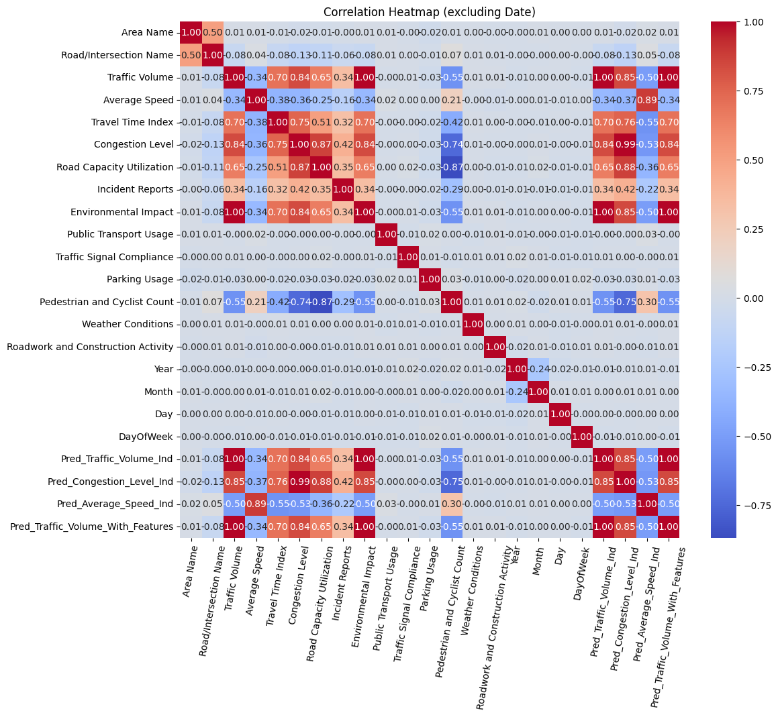
Correlation Analysis of Traffic
Traffic volume is strongly correlated with congestion (0.83) and environmental impact (1.0), showing that higher traffic directly worsens congestion and pollution.
Average speed has a negative correlation with traffic volume (-0.34) and congestion (-0.36), meaning more traffic slows vehicles down.
Road capacity utilization (0.65) and travel time index (0.69) also rise with traffic volume, reinforcing that overloaded roads increase delays.
Pedestrian ratio (-0.69) and parking load (-0.76) decrease as traffic rises, indicating reduced walkability and higher strain on parking.

Slide 5
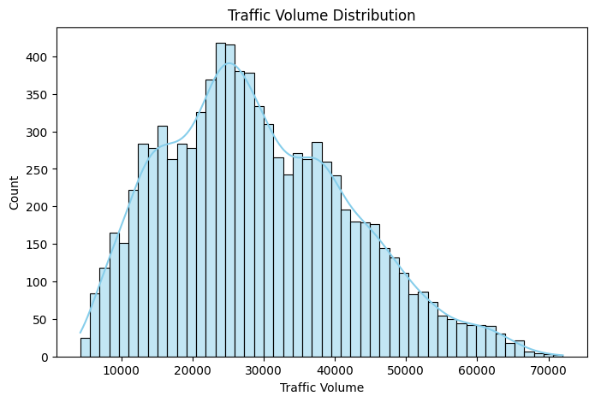
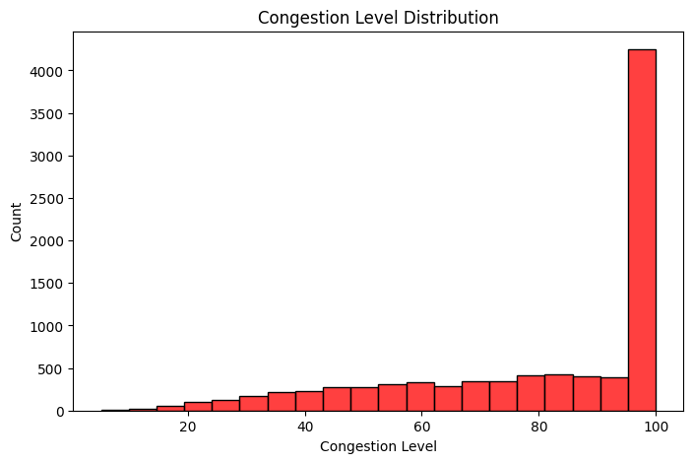
Traffic volume & Congestion level
Out of a total of 8,936 traffic records, peak Traffic Volume reached 72,039 vehicles, while the average traffic per
record was approximately 29,236 vehicles.
Congestion levels are high, with a mean of ~81%, a standard deviation of 23.5%, and several areas operating at
full capacity (100%).
The distribution shows that 25% of areas have congestion below ~64%, the median congestion is ~92%, and 75% of areas experience congestion at or above 100%, highlighting significant traffic bottlenecks across the city.
Minimum congestion was ~5%, indicating that some roads are almost free-flowing, but most areas face persistent high congestion.

Slide 6
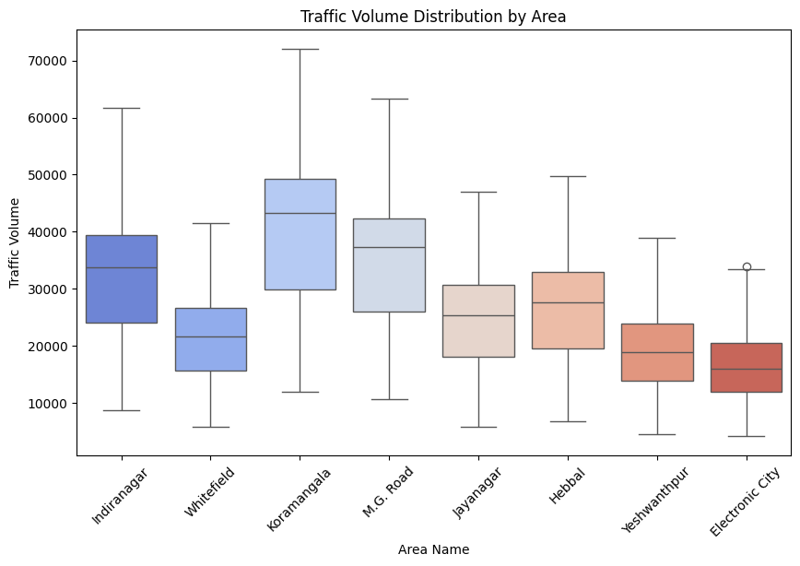
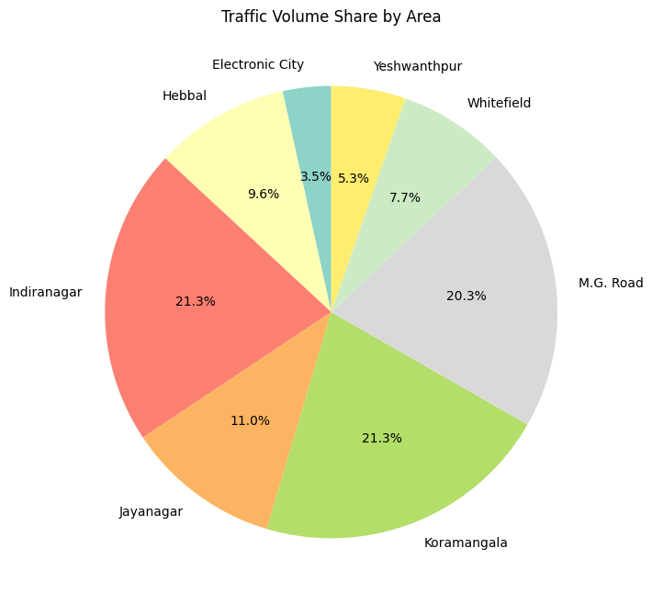
Area wise Traffic
Koramangala had the highest Traffic Volume: 55,695,194
Followed by Indiranagar: 55,529,148 and M.G. Road: 52,985,940
Jayanagar (28,857,360) and Hebbal (25,206,571) were next
Koramangala and Indiranagar alone accounted for nearly one-third of total traffic

Slide 7
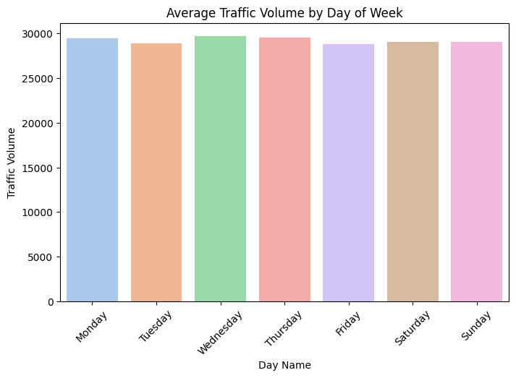
Traffic volume vs Day of Week
Busiest days were Wednesday (29,698 avg), Thursday (29,530), and Monday (29,510)
Sunday (29,105) and Saturday (29,063) were slightly lower
Traffic is generally higher on weekdays than weekends

Slide 8
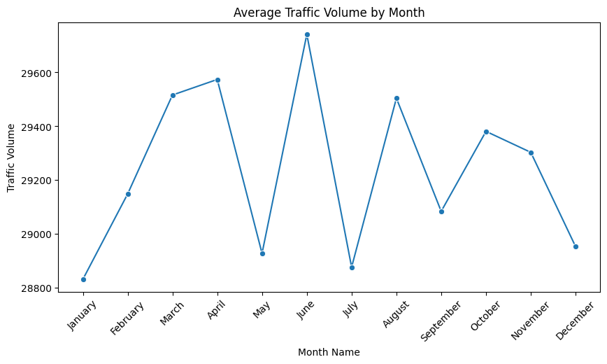
Traffic by Month of the Year
June recorded the highest average traffic: 29,742
April (29,574) and March (29,516) followed
August (29,504) and October (29,381) were also busy
Lowest traffic was observed in months outside this peak range

Slide 9
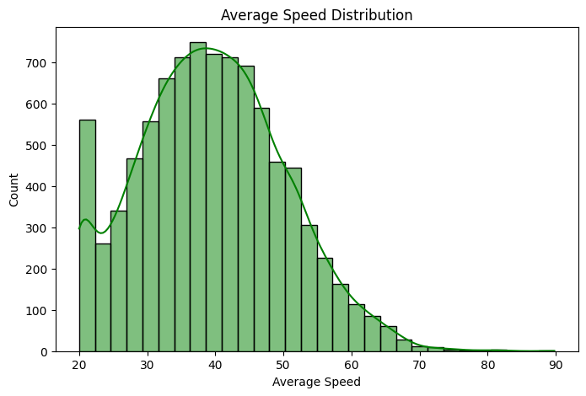
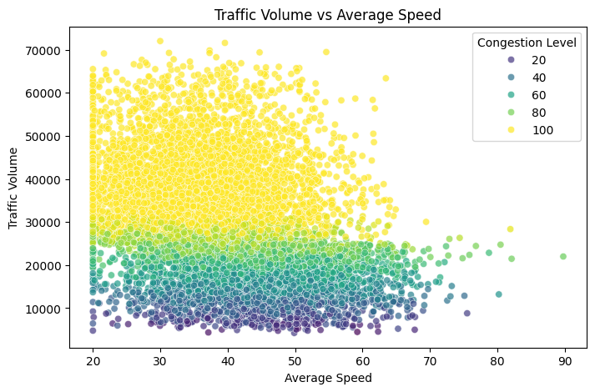
Speed & Travel Time Overview
High traffic volume areas, such as records with 50,000+ vehicles, often have average speeds below 40 km/h, and congestion at or near 100%, showing severe slowdowns during peak traffic.
Low traffic areas, for example, 7,399 vehicles, can achieve speeds of ~54 km/h with low congestion (~28%), demonstrating that speed is inversely related to traffic volume and congestion.
The Travel Time Index correlates positively with Traffic Volume (0.70), confirming that heavier traffic results in slower travel and longer trip durations.
High congestion consistently leads to slower average speeds, highlighting the need for traffic management interventions like signal optimization and alternate route planning.
Implications:
Maintaining an average speed of ~40 km/h in peak areas may require traffic rerouting, better public transport adoption, or dynamic lane management.
The wide range of speeds (20–90 km/h) indicates that certain areas can still allow free-flowing traffic, which can be leveraged to reduce congestion in critical hotspots.

Slide 10
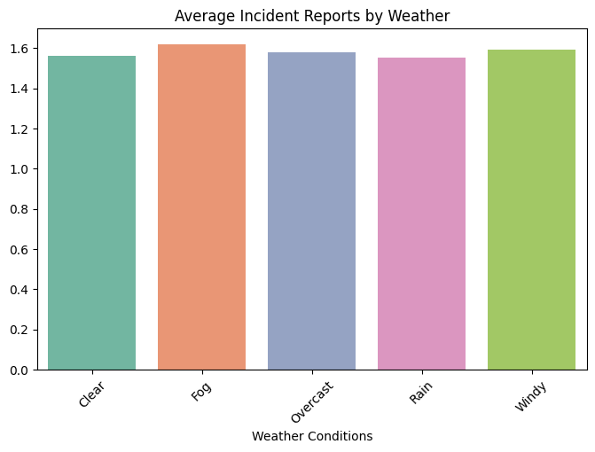
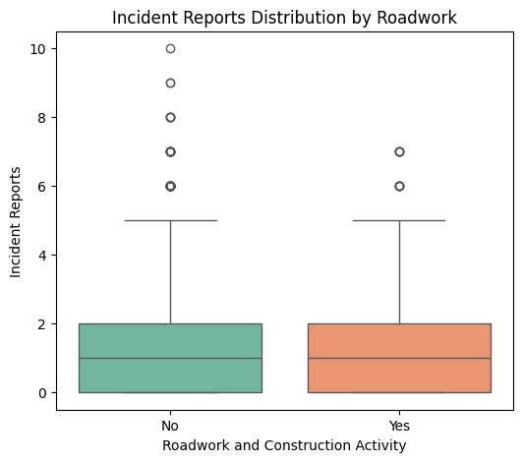
Incidents & Safety
Impact of Roadwork:
Areas without roadwork have slightly higher average incidents (~1.58) compared to areas with roadwork (~1.52), though the difference is minor.
Most records report 0–2 incidents, but maximum incidents can reach 10 in no-roadwork areas and 7 in roadwork areas, highlighting occasional hotspots.
Key Correlations:
Incident Reports correlate moderately with traffic hotspots (0.34), meaning busier areas tend to have more incidents.
The Pedestrian Ratio negatively correlates with Traffic Volume (-0.69), suggesting that crowded roads reduce pedestrian safety and indicate potential conflict points between vehicles and pedestrians.
Implications:
Even though incidents are low on average, traffic hotspots require targeted safety interventions, such as better signage, pedestrian crossings, and stricter traffic monitoring.
Planning around high-traffic zones, especially during peak hours, can improve overall road safety and reduce risks for pedestrians.

Slide 11
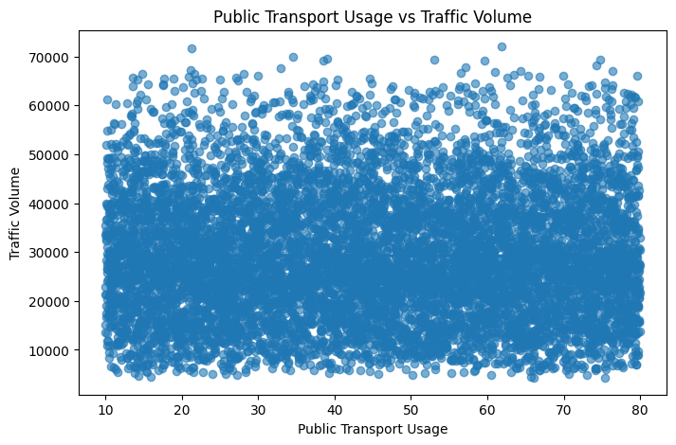
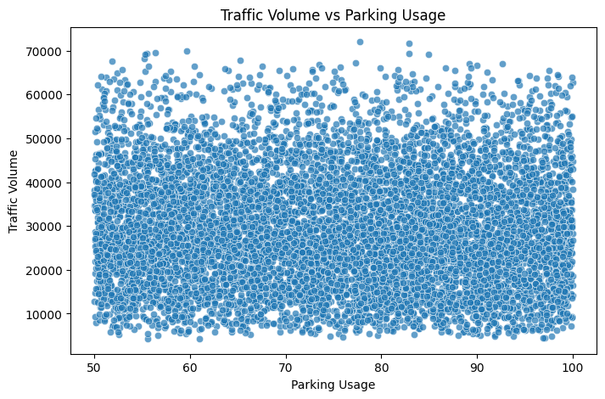
Public Transport & Parking
Public Transport:
Public Transport Usage shows moderate effectiveness in reducing congestion, with a correlation of 0.53 against traffic volume.
High usage areas (e.g., 70–72% usage) correspond to moderate traffic volumes, whereas very low usage (e.g., ~12%) coincides with higher traffic volume
(~31,760 vehicles), highlighting the potential of public transport to ease congestion.
Parking:
Parking Load negatively correlates with traffic volume (-0.76), meaning that areas with limited or highly utilized parking experience more congestion.
Sample data shows high parking usage (55–95%) in areas with both low and high traffic, indicating that insufficient parking contributes to traffic buildup, especially in busy zones.
Key Insights:
Promoting public transport adoption can moderately reduce congestion, especially in high-traffic areas.
Optimizing parking through real-time management, park-and-ride, or additional parking spaces can significantly ease congestion.
Areas with low public transport adoption and high parking load are likely traffic hotspots and should be prioritized for interventions.

Slide 12
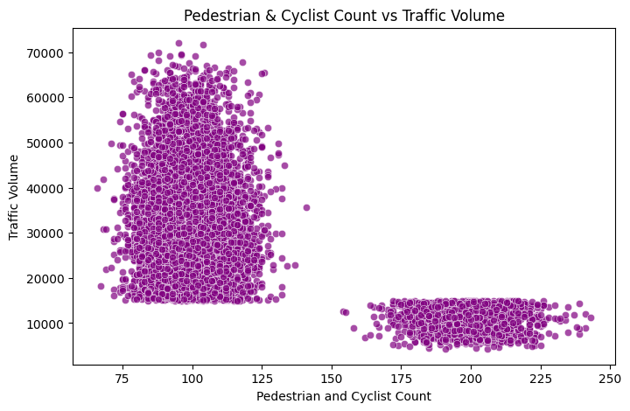
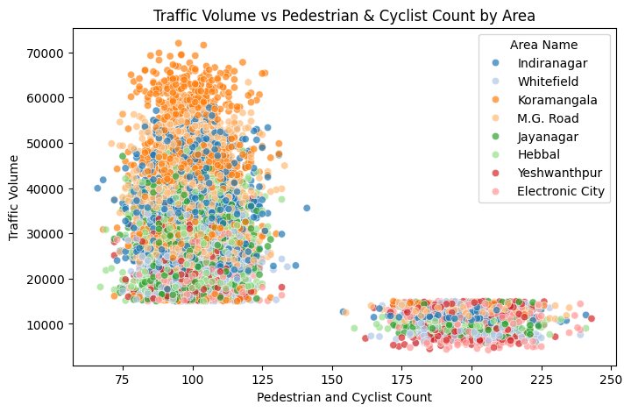
Pedestrian & Cyclist Overview
Pedestrian and cyclist counts range 92–189 per record, mostly 100–115, while traffic volumes span 7k–61k vehicles.
Moderate pedestrian activity occurs in busy areas, while extremely high traffic often limits pedestrian presence.
Area Highlights:
Indiranagar & Koramangala: 100–111 pedestrians, high traffic (30k–60k).
M.G. Road & Jayanagar: 92–115 pedestrians, moderate traffic (25k–48k).
Whitefield: 189 pedestrians with low traffic (~7k).
Hebbal: 91 pedestrians, moderate traffic (~31k).
Insights:
Pedestrian Ratio negatively correlates with traffic volume (-0.69), showing crowded roads reduce pedestrian safety.
High pedestrian areas with lower traffic need dedicated lanes/crossings for safer movement.
Moderate pedestrian presence in high-traffic zones indicates potential safety and congestion challenges.

Slide 13
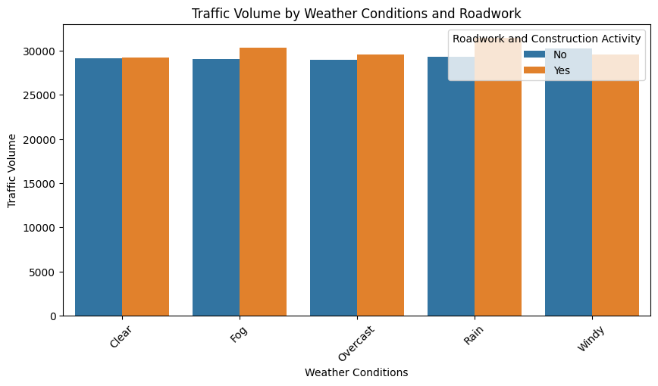
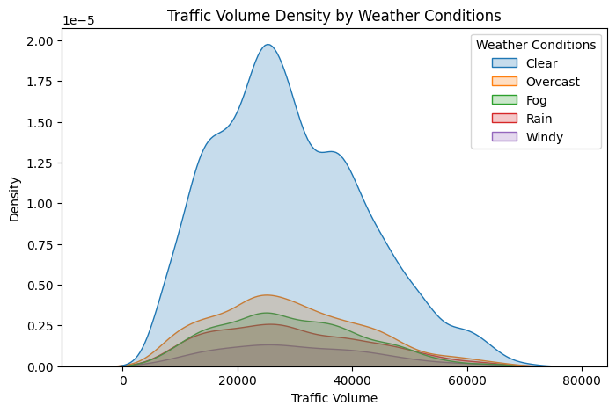
Traffic vs Weather
Average traffic volume is fairly consistent across weather conditions, ranging ~29k–30k vehicles, with Windy days slightly higher (~30,163).
Median volumes: Clear (27,447), Fog (27,789), Overcast (27,527), Rain (27,824), Windy (29,133).
Traffic shows moderate variability under all conditions (Std ~12k–13.5k), meaning weather alone does not drastically change traffic patterns.
Public transport usage varies, with some high-traffic days seeing low adoption (e.g., 12.85%), suggesting weather-independent travel behaviour.
Roadwork slightly increases traffic on some days (e.g., Rain: 29,343 → 31,438 with roadwork), highlighting localized congestion impacts.

Slide 14
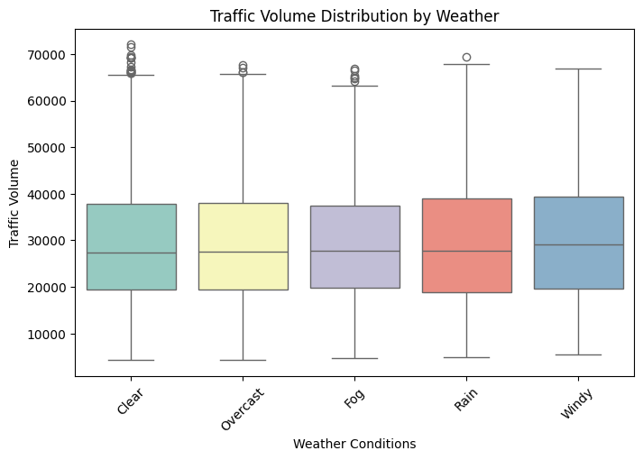
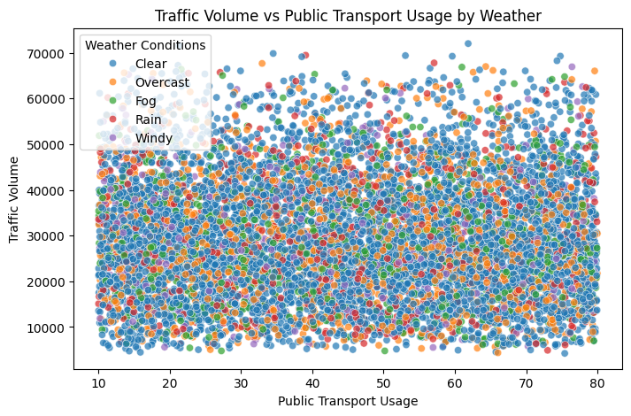
Environmental Impact:
Environmental impact is perfectly correlated with traffic volume (1.0) and strongly with congestion, showing high-traffic areas contribute the most to pollution.
Implication: Targeted interventions in congested zones (e.g., promoting public transport, optimizing parking, or signal timing) can significantly reduce emissions.
Key Insight:
Weather has minimal effect on traffic volume; congestion and traffic volume are the primary drivers of environmental impact.

Slide 15
Over all Insights
1. Overall Patterns
Traffic Volume: Average ~29,236 vehicles per record; peaks at 72,039 and
minimum at 4,233. Koramangala and Indiranagar alone account for nearly
one-third of total traffic.
Average Speed: ~39.4 km/h; slows down significantly in congested areas (min 20 km/h, max 89.8 km/h). High traffic leads to slower travel.
Congestion Level: High overall (~81%), with some areas operating at full capacity and extreme cases exceeding 380% of nominal road capacity.
Incident Reports: Low on average (~1.57 per record) but correlate with traffic hotspots (0.34). Highest incidents occur in Koramangala and M.G. Road.
Pedestrian & Cyclist Activity: Counts vary 92–189 per record, generally higher in moderately busy zones, indicating safety concerns in crowded roads (Pedestrian Ratio vs Traffic Volume = -0.69).
Environmental Impact: Strongly correlated with traffic volume (1.0) and congestion; heavily congested areas contribute the most to emissions.
Temporal Patterns:
Weekdays (Mon–Thu) have higher traffic (~29,510–29,698 avg).
Weekends slightly lower (~29,063–29,105).
Peak Months: June (29,742), April (29,574), March (29,516); lower traffic outside these months.

Slide 16
Weather Effects: Traffic volume slightly higher during Windy and Rainy
conditions; public transport usage can mitigate congestion even in adverse
weather.
2. Correlations
Traffic Volume vs Congestion Level: 0.84 → higher vehicles significantly increase congestion.
Traffic Volume vs Travel Time Index: 0.70 → more vehicles lead to slower travel.
Traffic Volume vs Road Capacity Utilization: 0.65 → traffic closely matches how much of road capacity is used.
Pedestrian Ratio vs Traffic Volume: -0.69 → crowded roads reduce pedestrian safety.
Parking Load vs Traffic Volume: -0.76 → limited parking worsens congestion.
Average Speed vs Congestion Level: -0.36 → higher congestion slows speeds.
Traffic Volume vs Incident Reports: 0.34 → more traffic increases incident likelihood.
3. Area-wise Insights
Highest Traffic Volumes: Koramangala (~40.8k), M.G. Road (~35.3k), Indiranagar (~32.3k).
Lowest Traffic Volumes: Yeshwanthpur (~18.9k), Electronic City (~16.3k).
Speeds: Slowest in Koramangala (~36 km/h), fastest in Electronic City (~43.6 km/h).
Congestion: Most severe in Koramangala (94%), Indiranagar (88%), M.G. Road (91%).
Incident Reports: Highest in M.G. Road (~1.86) and Koramangala (~1.85), lowest in Electronic City (~0.78).

Slide 17
4. Variability (Standard Deviation)
Traffic fluctuations are largest in Koramangala (SD ~14.1k) and M.G. Road (SD ~11.9k).
Speed is relatively consistent across areas (SD ~9.7–10.9 km/h).
Congestion variation is highest in Whitefield (SD ~23.8) and lowest in Koramangala (SD ~15).
5. Summary for Safety and Flow
High traffic areas like Koramangala and M.G. Road experience high congestion and moderate incident reports.
Areas with moderate traffic (Electronic City, Yeshwanthpur) maintain better speed and lower congestion.
Monitoring pedestrian safety and incident hotspots is crucial in high-volume zones.

Slide 18
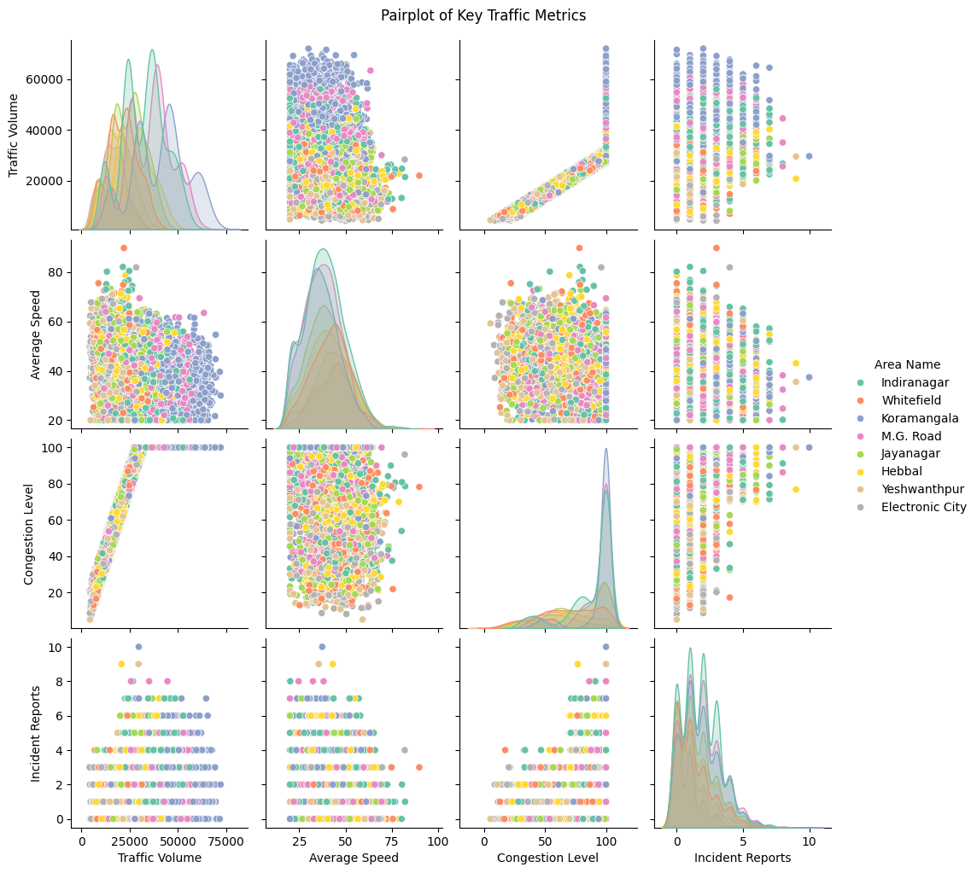

Slide 19
RECOMMENDATIONS
1. Focus on Busy Areas
Hotspots: Koramangala, Indiranagar, and M.G. Road carry the heaviest load (~32–41k vehicles on average) with congestion levels reaching 88–94%.
Smarter Signals: Use adaptive traffic lights that change timings based on real-time conditions.
Relief Measures: Promote flexible office timings, staggered shifts, and alternative routes during peak hours.
Micro-Zoning: Break large traffic-heavy zones into smaller, more manageable sections.
2. Keep Traffic Moving
Dynamic Lanes: Open reversible or dedicated lanes depending on peak direction.
Speed Adjustments: Set variable speed limits according to congestion and incidents.
Live Monitoring: Deploy sensors and cameras to detect slow zones and act quickly.
Policy Levers: Try congestion pricing, carpool incentives, or temporary restrictions during peak hours.

Slide 20
3. Improve Safety
Incident Hotspots: M.G. Road, Indiranagar, and Koramangala show higher risk
(~1.8 incidents per record).
Safer Infrastructure: Dedicated pedestrian and cycle lanes, crossings, and
signage.
Awareness Drives: Run campaigns on weekdays (Mon, Wed, Thu) when traffic is at its highest (~29.5–29.7k vehicles/day).
Risk Mapping: Use reports and pedestrian data to identify accident-prone zones.
4. Public Transport & Parking
Boost Usage: Public transport helps ease congestion (correlation 0.53). Incentivize with discounts or priority lanes.
Smart Parking: Lack of parking worsens jams (correlation –0.76). Offer real-time parking guidance and expand facilities.
Park & Ride: Set up hubs outside city centers for commuters.
Multi-Modal Links: Improve last-mile access with bikes, metros, and shared mobility.
5. Environmental Considerations
Pollution Hotspots: Koramangala and M.G. Road contribute the most emissions.
Eco-Options: Encourage EVs, green buses, and low-emission corridors.
Air Quality Tracking: Monitor pollution in real time to guide interventions.
Urban Planning: Expand green corridors and pedestrian-friendly layouts.

Slide 21
6. Plan Smart with Data
Predictive Tools: Use past and live data to forecast congestion and travel times.
Seasonality: Peak months (June, April, March) and weekdays show higher traffic.
Always On: Monitor volumes, congestion, incidents, and environmental metrics continuously.
Dashboards: Provide real-time alerts to authorities and drivers.
7. Community & Behavioural Change
Driver Education: Share congestion maps and alternative routes.
Carpool Culture: Reward shared rides to reduce solo driving.
Citizen Input: Allow people to report hazards, incidents, and parking issues via apps.
Live Updates: Push congestion and reroute alerts directly to mobile apps.

Slide 22
8. Advanced & Adaptive Approaches
Traffic Variability: Koramangala (SD ~14k, CV ~0.35) and M.G. Road (SD ~11.9k, CV ~0.33) show high variability → need adaptive solutions.
Smarter Signals: Combine vehicle, cyclist, and pedestrian data to set signal timings.
Integrated Strategy: Balance congestion, safety, and speed for better flow.
9. Key Takeaways
Koramangala + Indiranagar = 1/3 of total traffic → focus here gives maximum impact.
Weekdays > Weekends: Solutions must be time-specific.
Public Transport + Parking = Major Relief: Both strongly reduce congestion.
Environment & Safety: Traffic management must address emissions and accident risks.
Adaptive, Data-Driven: Real-time, predictive strategies are the way forward.

Slide 23
Thank you
Bangalore Smart City Traffic Analysis
- Analysis and Prediction of Bangalore Smart City Traffic Using Data Science and Machine Learning
Presented By
Mr. MDZ

